Slide 1
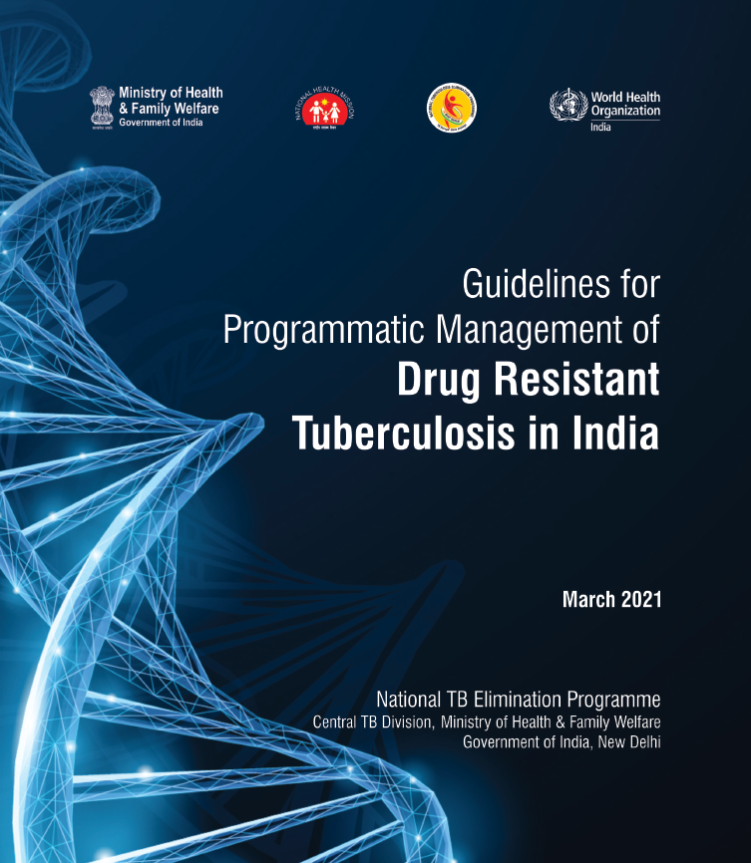

Slide 2



NTP
RNTCP
NTEP

Slide 3
Isoniazid-resistant TB (Hr-TB)
Rifampicin resistant TB (RR-TB)
Poly-drug resistant TB (PDR-TB)
Multidrug-resistant TB (MDR-TB)
Pre-extensively drug-resistant TB (Pre-XDR-TB)
Extensively drug-resistant TB (XDR-TB)

Slide 4
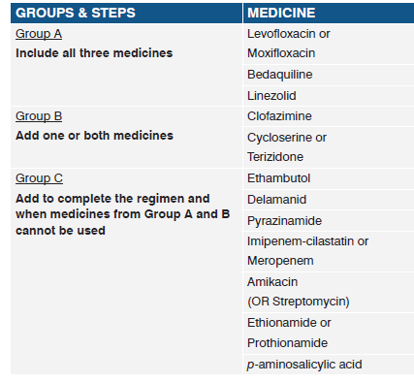
GROUPING OF DRUGS

Slide 5
DRUGS NOT INCLUDED IN GROUP A-C
Kanamycin and capreomycin – no longer recommended
Gatifloxacin and high-dose Isoniazid (Hh) - very few patients.
Thioacetazone was not used at all.
Clavulanic acid - only as a companion agent to the carbapenems

Slide 6

Shorter injectable containing regimen
INITIAL PHASE – High dose Moxifloxacin
(4-6 months) Kanamycin/Amikacin
Ethionamide
Clofazimine
Pyrazinamide
High dose Isoniazid
Ethambutol
CONTINUATION PHASE - High dose Moxifloxacin
(5 months) Clofazimine
Pyrazinamide
Ethambutol
INJECTABLE ORAL REGIMEN

Slide 7
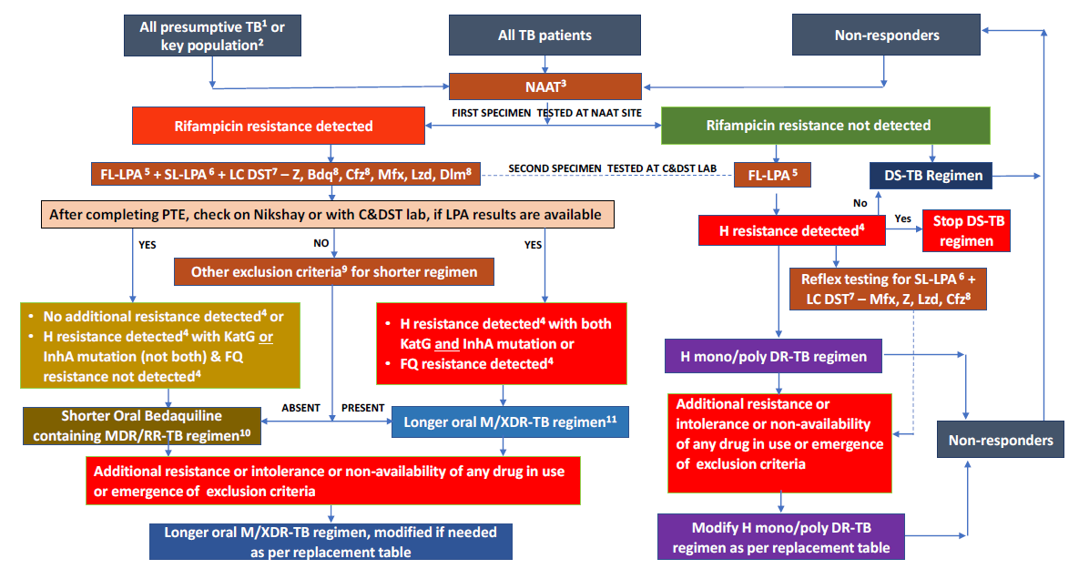

Slide 8
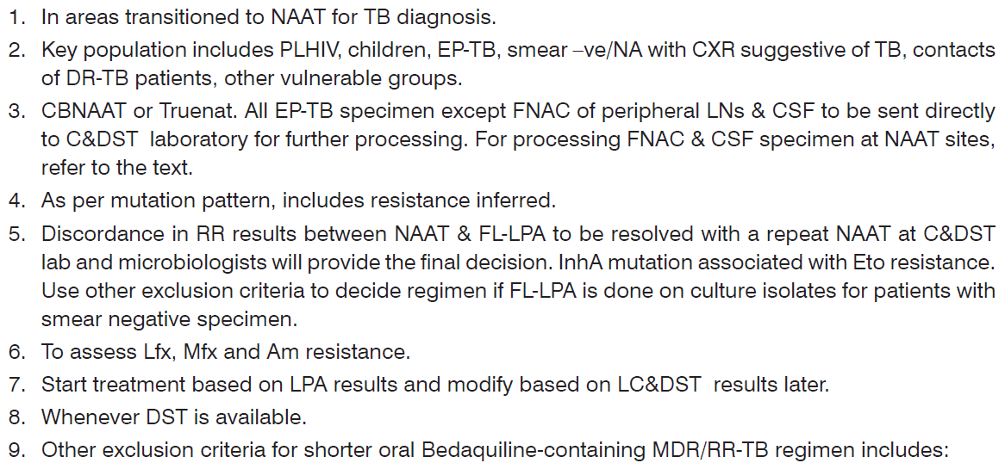
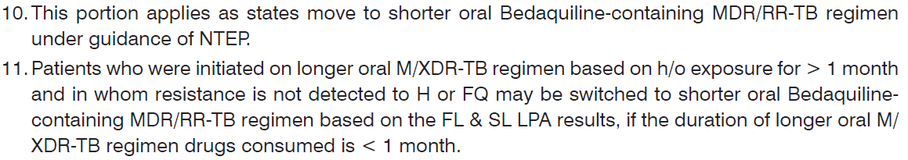

Slide 9
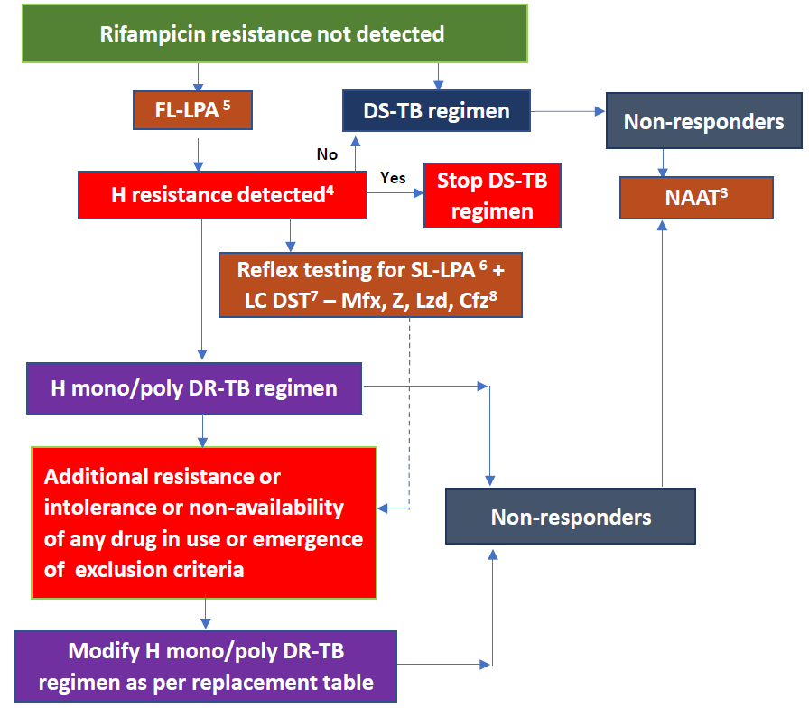

Slide 10
H mono/poly DR-TB regimen (R resistance not detected & H resistance detected) under NTEP:
For 6-9 months - Levofloxacin
Rifampicin
Ethambutol
Pyrazinamide

Slide 11
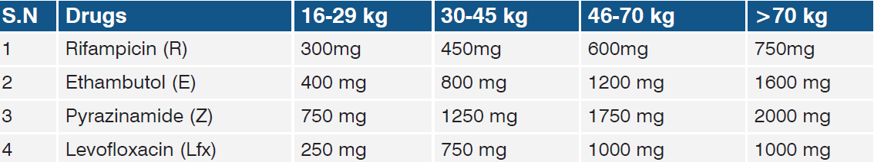

Slide 12
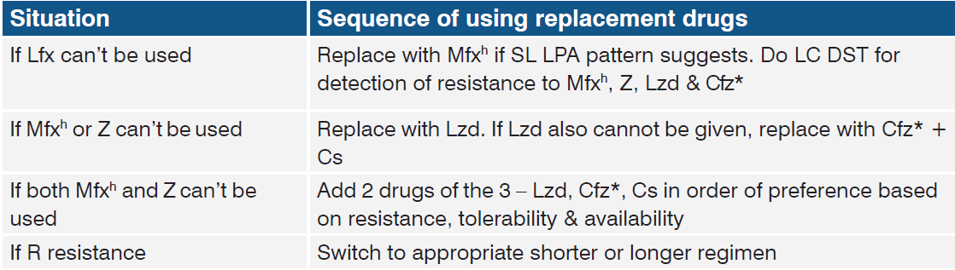

Slide 13
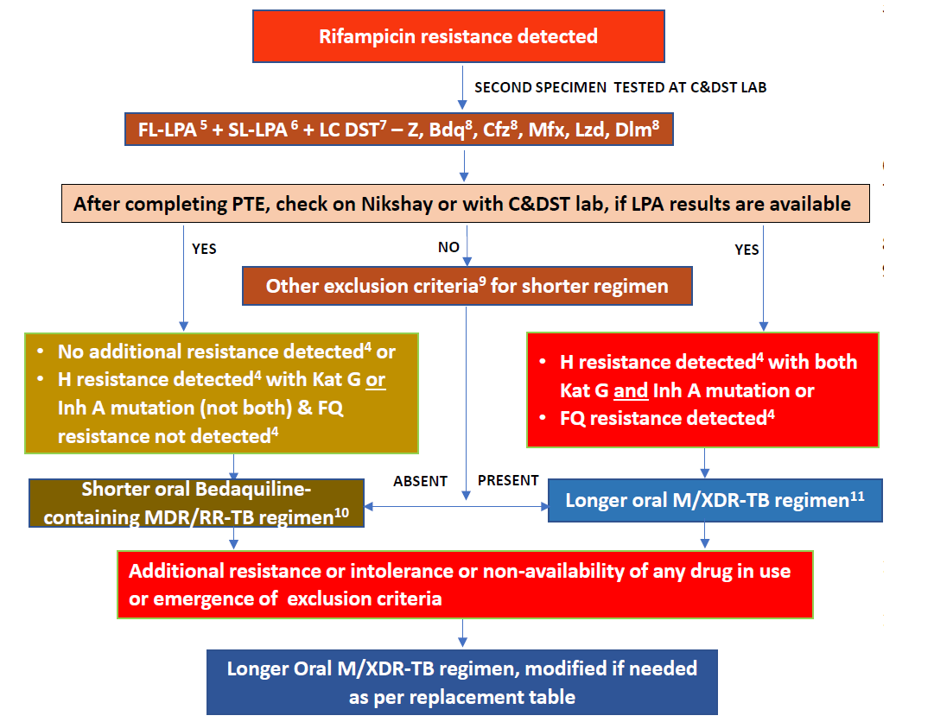

Slide 14
Inclusion criteria
►►Children, 5 - 18 years of age and weighing at least 15 kg - special needs, in consultation with the pediatrician
►►No history of exposure to previous treatment with second-line medicines in the regimen for more than 1 month
►►No extensive TB disease
►►No severe extra-pulmonary TB
►►Women who are not pregnant or lactating

Slide 15
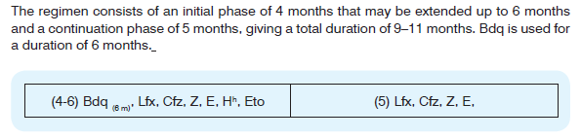
Shorter oral Bedaquiline-containing MDR/RR-TB regimen
INITIAL PHASE – Bedaquiline (6 months)
(4 months, extended Levofloxacin
Up to 6 months) Clofazimine
Pyrazinamide
Ethambutol
High dose Isoniazid
Ethionamide
CONTINUATION PHASE – Levofloxacin
(5 months) Clofazimine
Pyrazinamide
Ethambutol
TOTAL DURATION – 9 to 11 Months

Slide 16
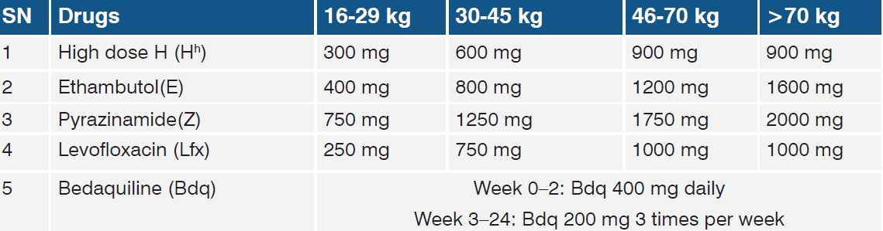
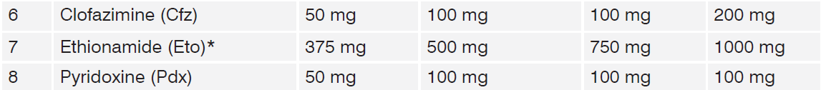

Slide 17
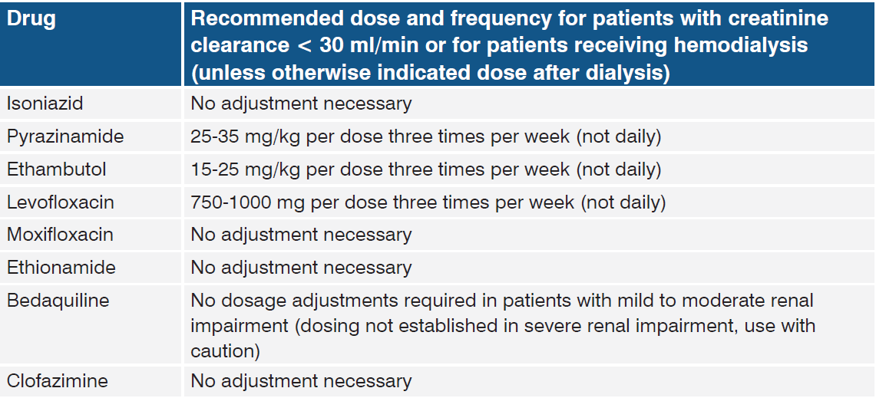

Slide 18
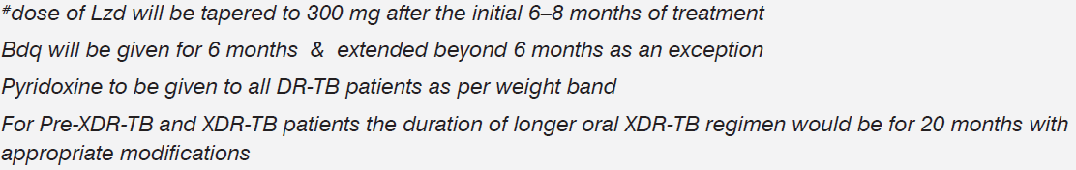
Longer oral M/XDR-TB regimen
18-20 months
Levofloxacin
Bedaquiline
Linezolid
Clofazimine
Cycloserine

Slide 19
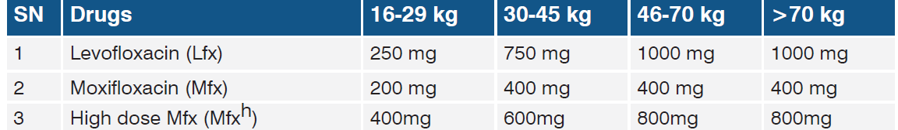
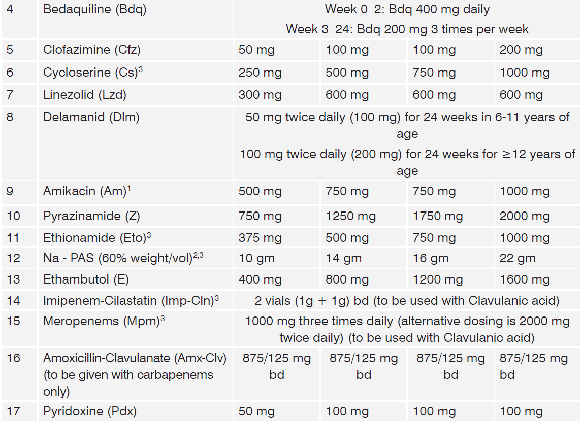

Slide 20
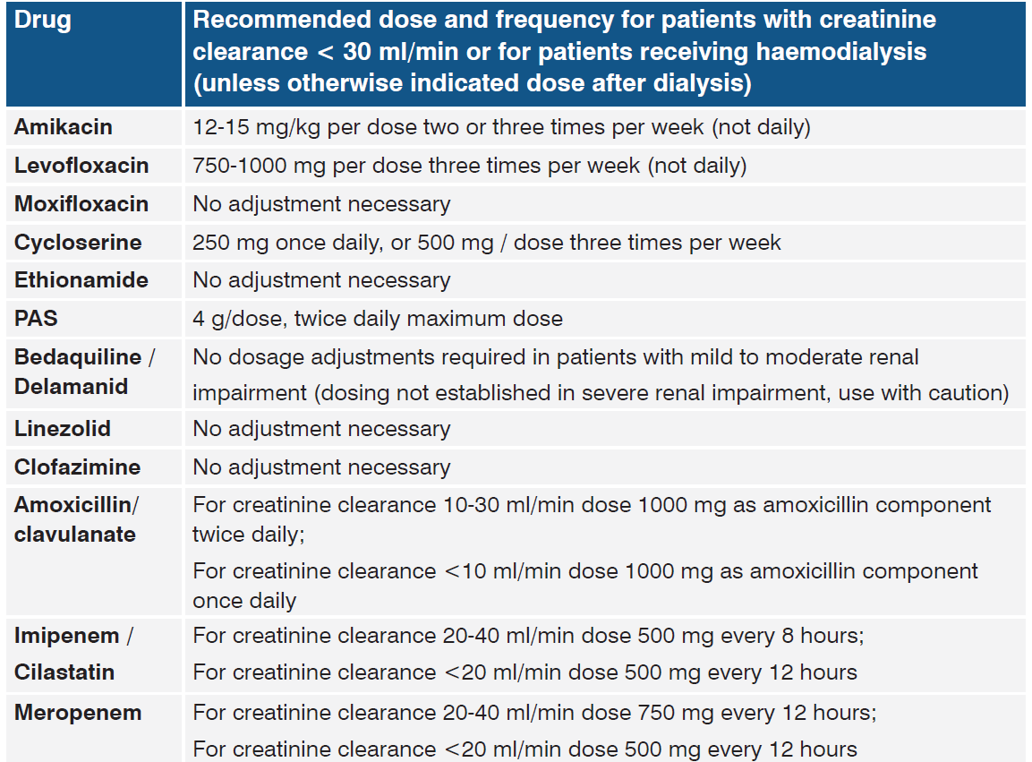

Slide 21
Bedaquiline, Pretomanid, Linezolid (BPaL) regimen
Pretomanid - 200 mg once daily for 26 weeks,
Bedaquiline - 400 mg once daily for the first 2 weeks of treatment (days 1–14) and then 200 mg three times a week for 24 weeks, and
linezolid - 1200 mg once daily for 24 weeks.

Slide 22
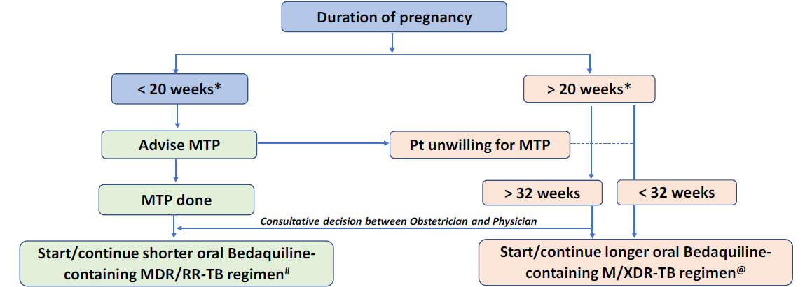

Slide 23
THANK YOU

